Slide 1
Smart Sensing Network Through IoT
Group Members:
Navyashree Garapati (C0765780)
Vaibhav Jivani (C0765530)
Archana Kalathil Venu (C0765532)
Geethu Anna Jacob (C0760834)

Slide 2
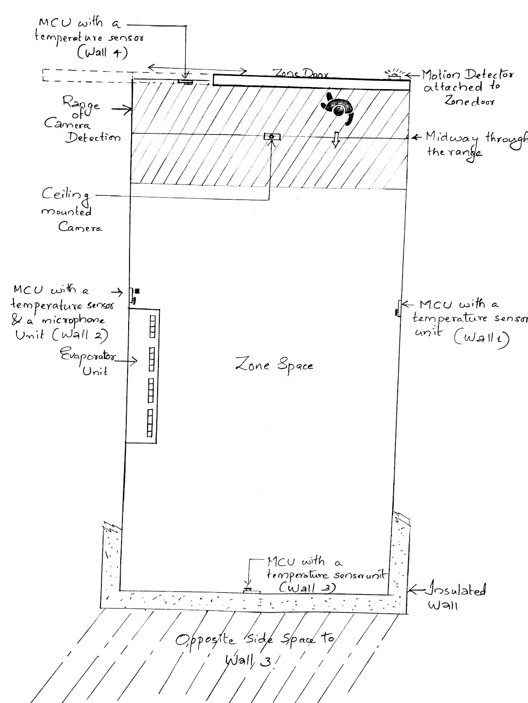
Main Concept

Slide 3
Main Parts of the Project
Three main Parts:
Raspberry Pi (Central Hub)
Teensy connected to door sensor and relay to control lighting (communicating to Raspberry pi via BLE).
Teensy connected with temperature sensor (communicating to Raspberry Pi via BLE).

Slide 4
Working
Part 1 – Software : Bluez, Gattlib library for BLE, Arduino Bluefruit library
Temperature sensor – sends temperature data every few milliseconds to teensy(i2c).
Teensy receive temperature values and send it to Raspberry Pi via BLE.
Part 2 – Software : Bluez, Gattlib library for BLE, Arduino Bluefruit library
Door Sensor- Teensy- Relay- Lighting.
BLE
Raspberry Pi

Slide 5
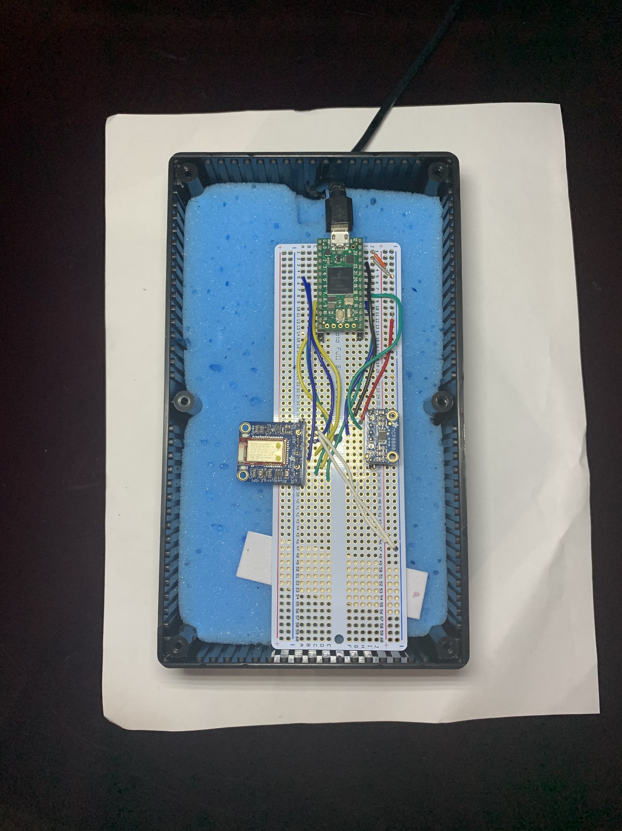
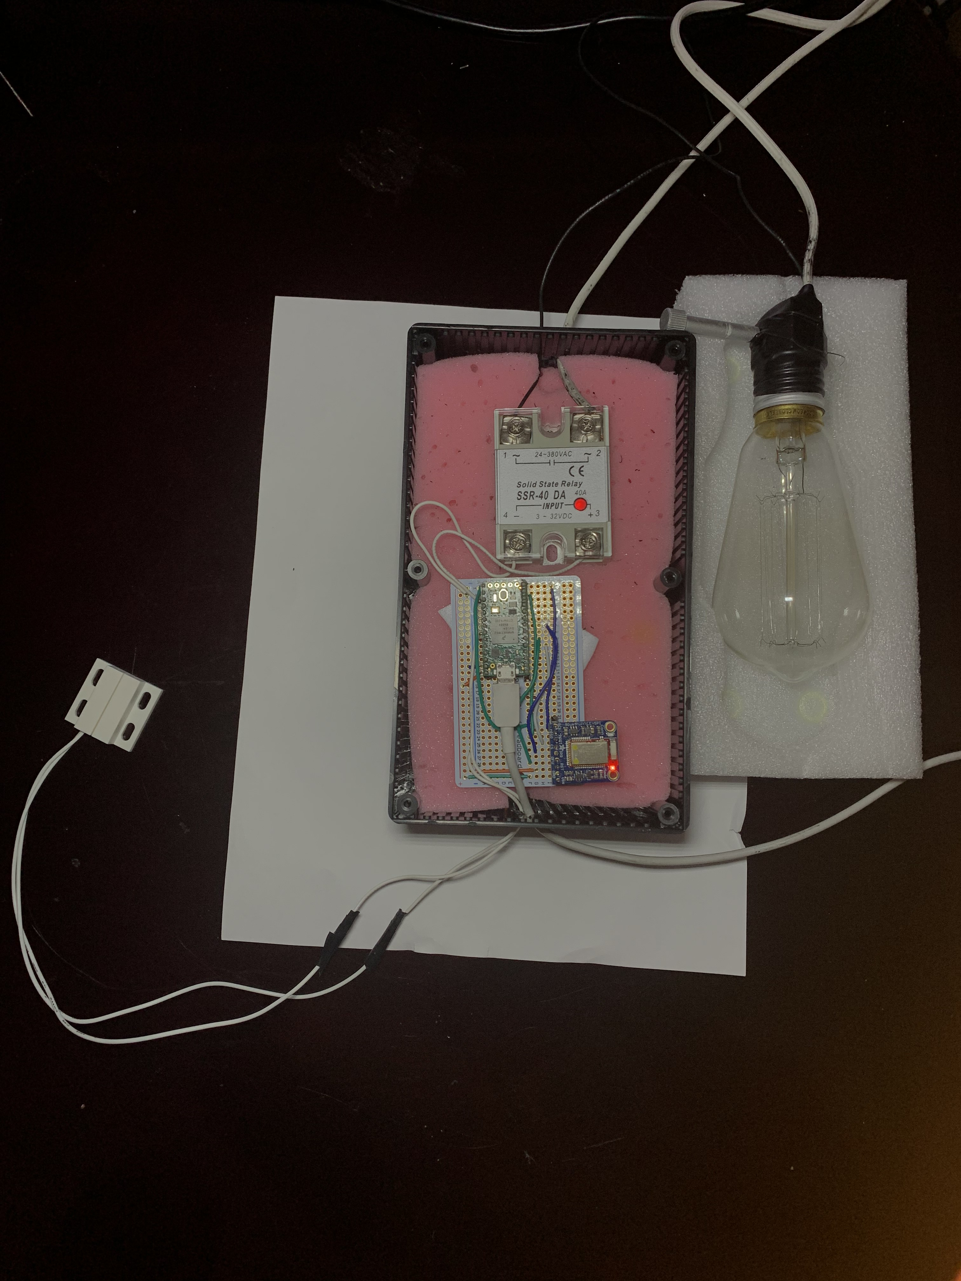
Teensy Setup

Slide 6
Working
Part 3 – Software : OpenCV
Capturing live images and counting number of people inside the zone at any given time
Tracking time for which the zone is occupied
Part 4 – Software : Qt, AWS SDK for S3
Uploading the real-time measurements to AWS Cloud and Github every few minutes.
Displaying the measured data

Slide 7
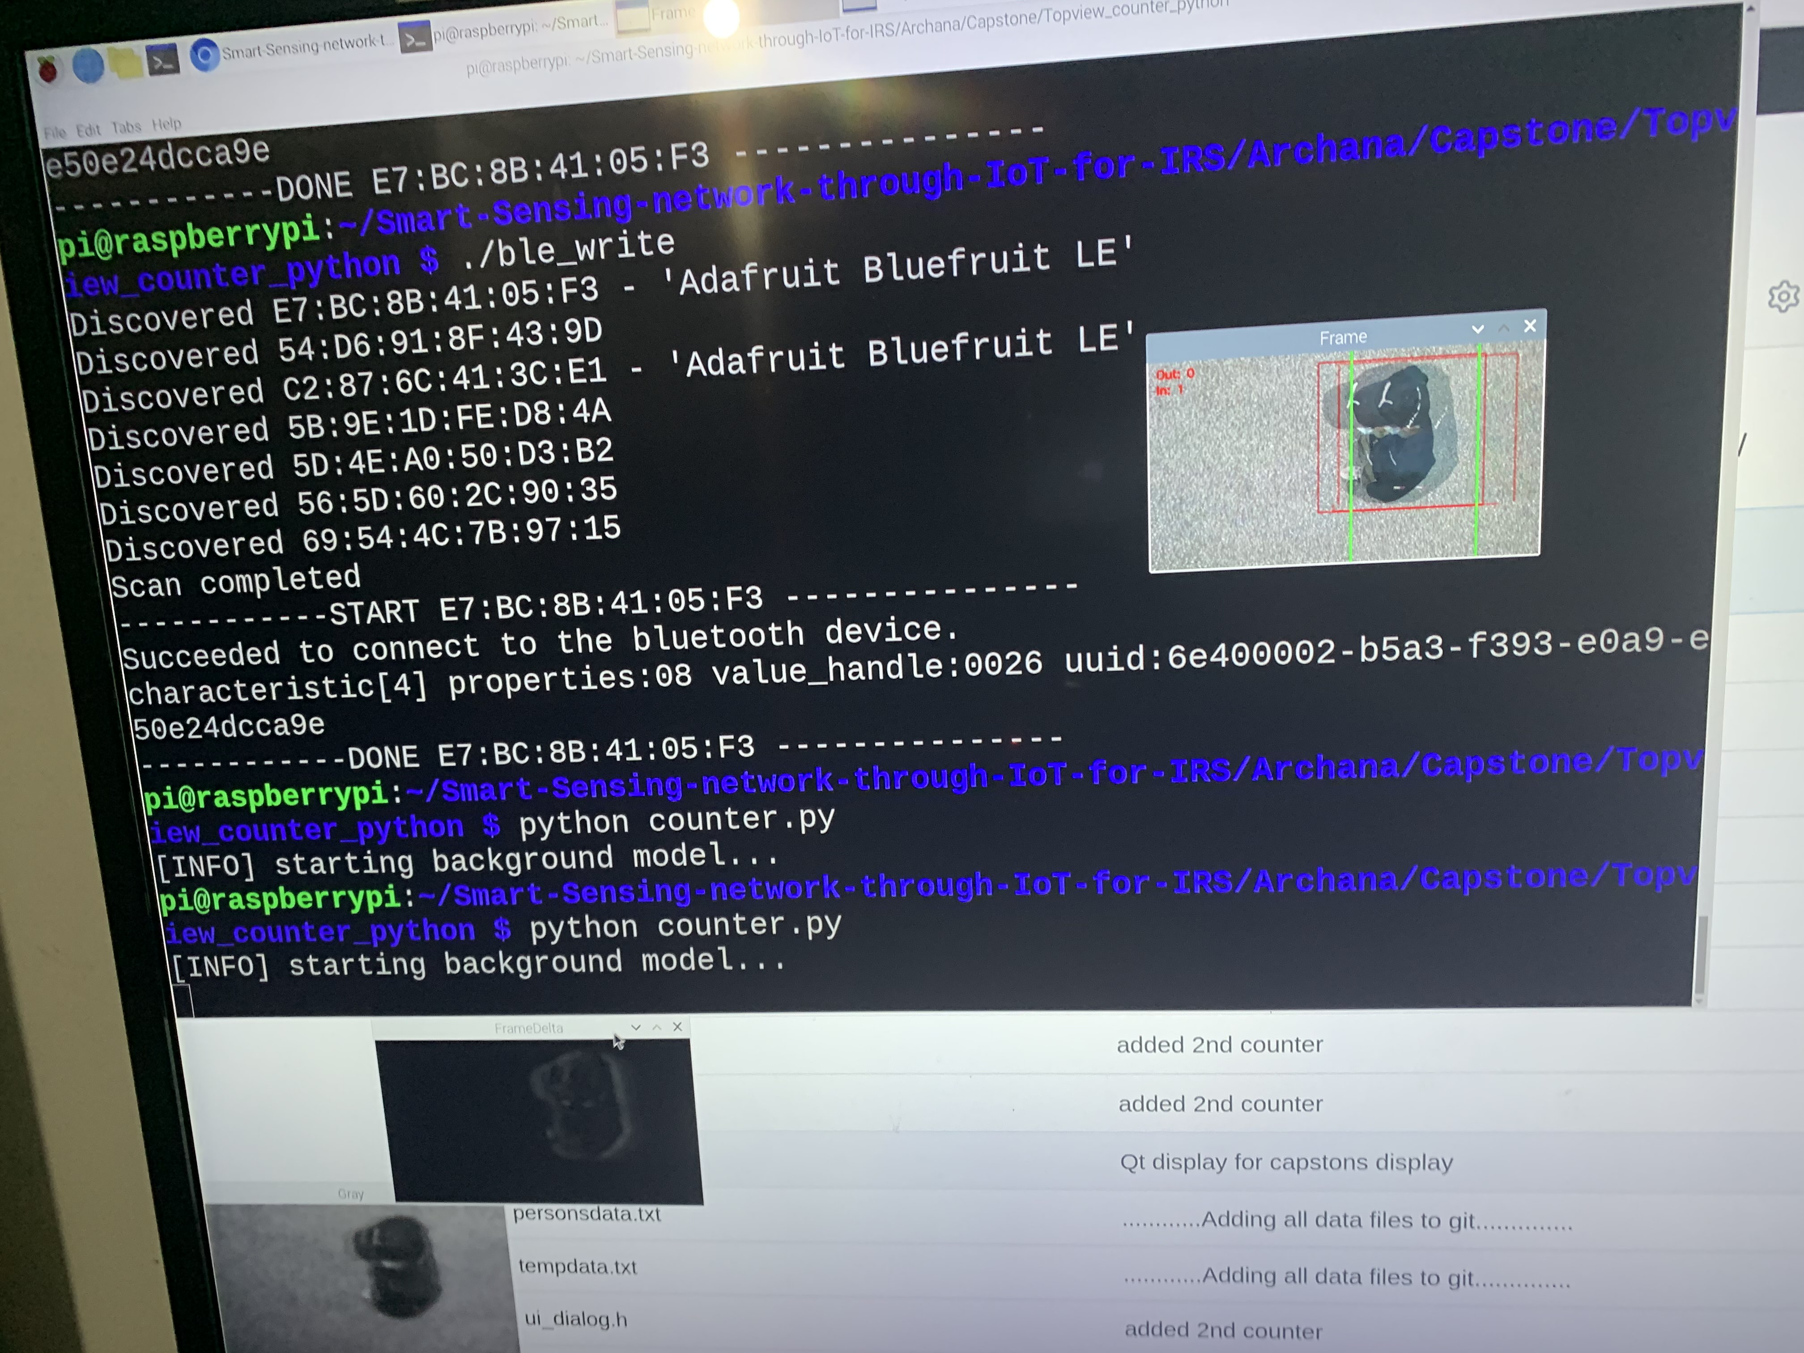
Raspberry Pi detecting the number of people inside the zone

Slide 8
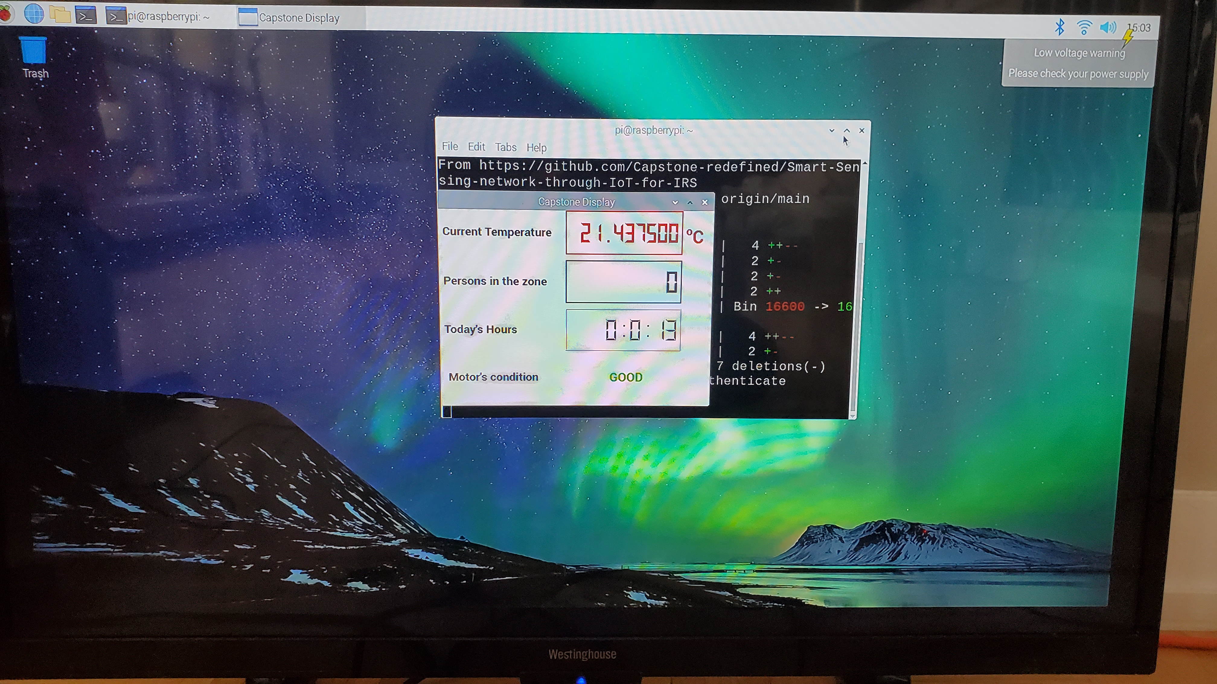
Real-time GUI Display

Slide 9
Short video…….
https://www.youtube.com/watch?v=X3Mn9leFYzM
https://www.youtube.com/watch?v=l3yf8G_RZio

